Slide 1
Should Government Regulate Moral Algorithms of Autonomous Vehicles?
Presented by Kaiqi Wang, Zhongheng Yang

Slide 2
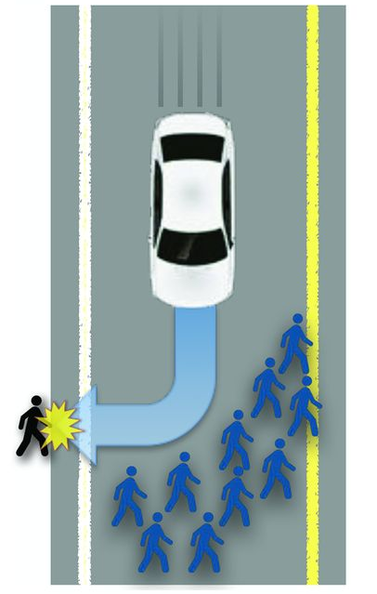
Question
Some crashes will require autonomous vehicle to decide who should be saved or sacrificed.
Government Regulated vs. Not Regulated

Slide 3
Data
6 online surveys (n = 1928 total participants, U.S. residents only)
 | Study 5 | Study 6
Subject | People’s attitudes toward legally enforcing utilitarian sacrifices. | People’s likelihood of purchasing the autonomous vehicles whose algorithms had been regulated by the government.
Comparison | Morality of sacrifice Legally Enforce Sacrifice | Purchase if regulated Purchase if not regulated

Slide 4
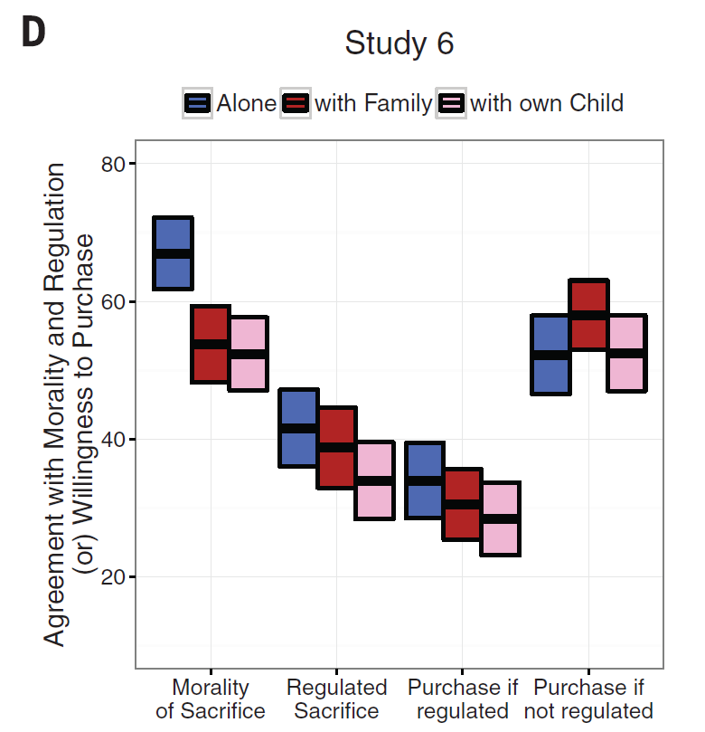
Study 6（Figure 3.D）

Slide 5
Agreement with Morality and Regulation
（or）Willingness to Purchase

Slide 6
Alone

Slide 7
Alone
with Family

Slide 8
Alone
with Family
with own Child

Slide 9

$ 1,000,000
（Regulated by government）

Slide 10

$ 1,000,000
（Regulated by government）
$ 1,000,000
（Not Regulated by government）

Slide 11
Reluctant to accept governmental regulation

Slide 12
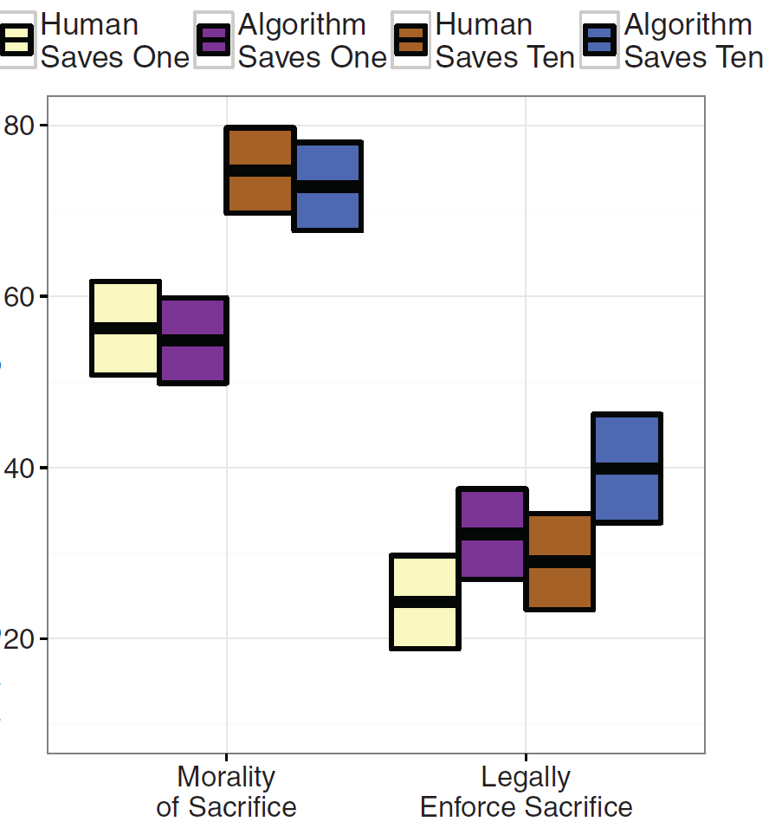

Slide 13
Study 5（Figure 3.C）
95% CI（confidence interval，置信区间）
48
36

Slide 14
Conclusion
Participants were much less likely to consider purchasing an AV with such regulation than without (P < 0.001).
$ 1,000,000
（Regulated by government）
$ 1,000,000
（Not Regulated by government）

Slide 15
Thank you for listening

